Slide 1


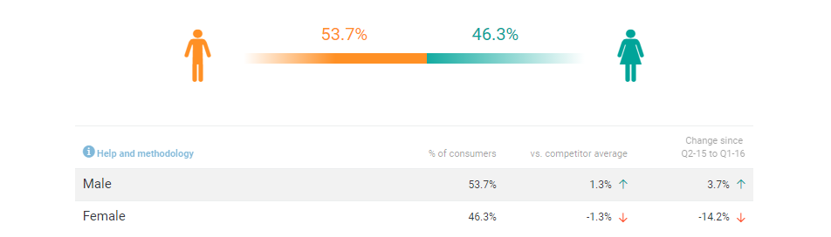
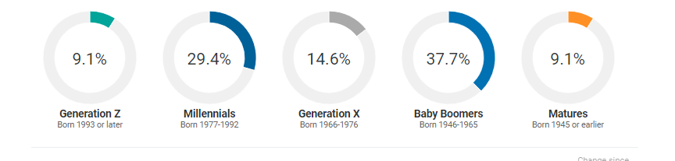

About Consumer Tracking
Ratings Identify operator strengths and weaknesses based on attribute ratings
Competition Know other players in the market and find lost business based on the consumer consideration set
Brand Mentions Use social listening to engage with influencers and tap into the buzz around brands
Visit Occasions Understand consumers’ characteristics and what drives their visits.
Menu Items See what items consumers purchase most
Download Get PowerPoint presentations of your data with a click of a button
CBM utilizes 140,000 consumer foodservice visits each year for 200 brands
| technomic.com

Slide 2
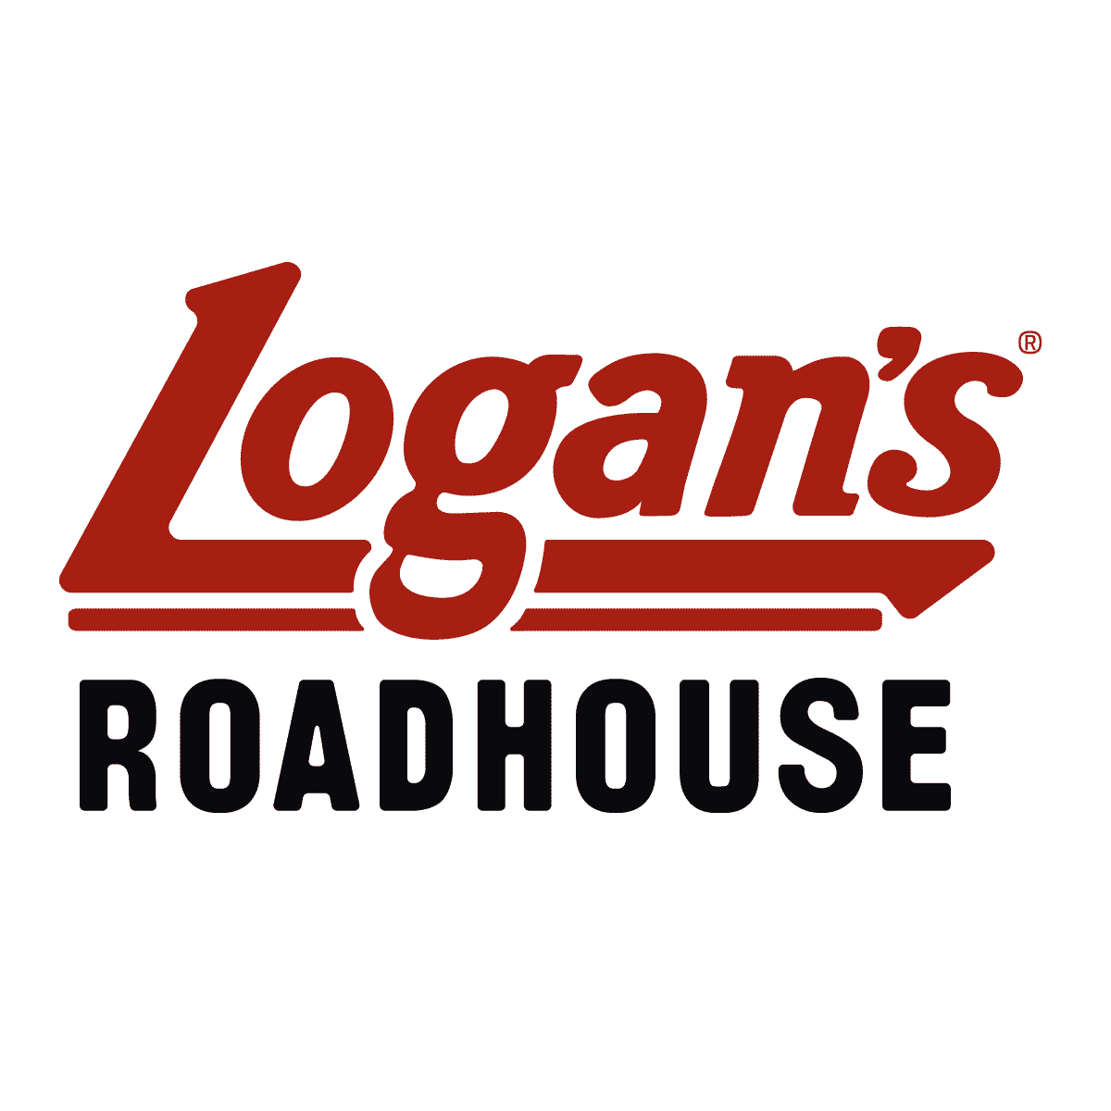
Top-Line Competitive Brand Assessment
KPI Stats
April 2019
Powered by Consumer Brand Metrics

Slide 3
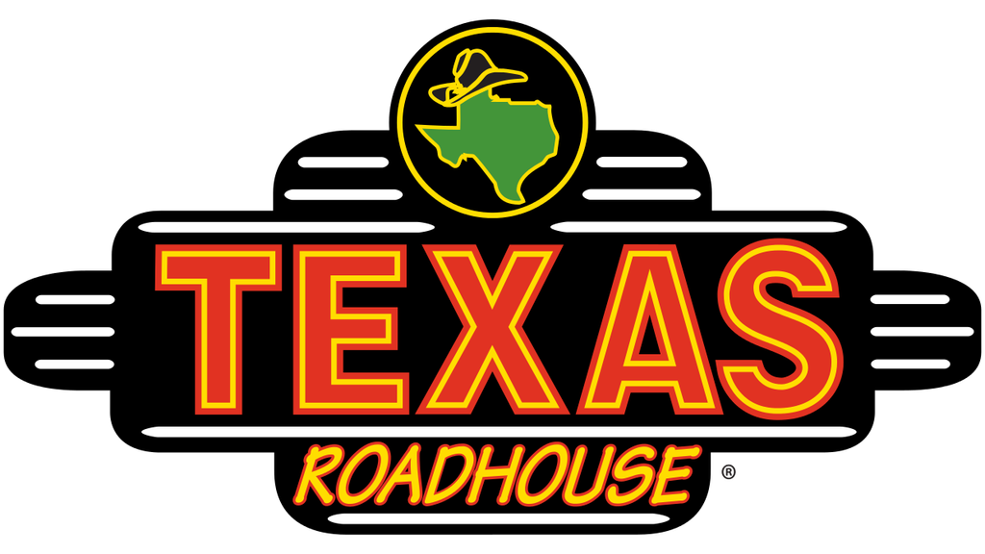



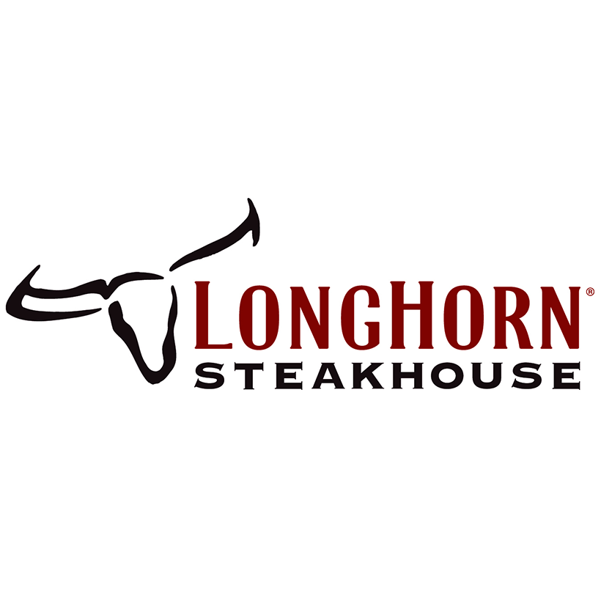
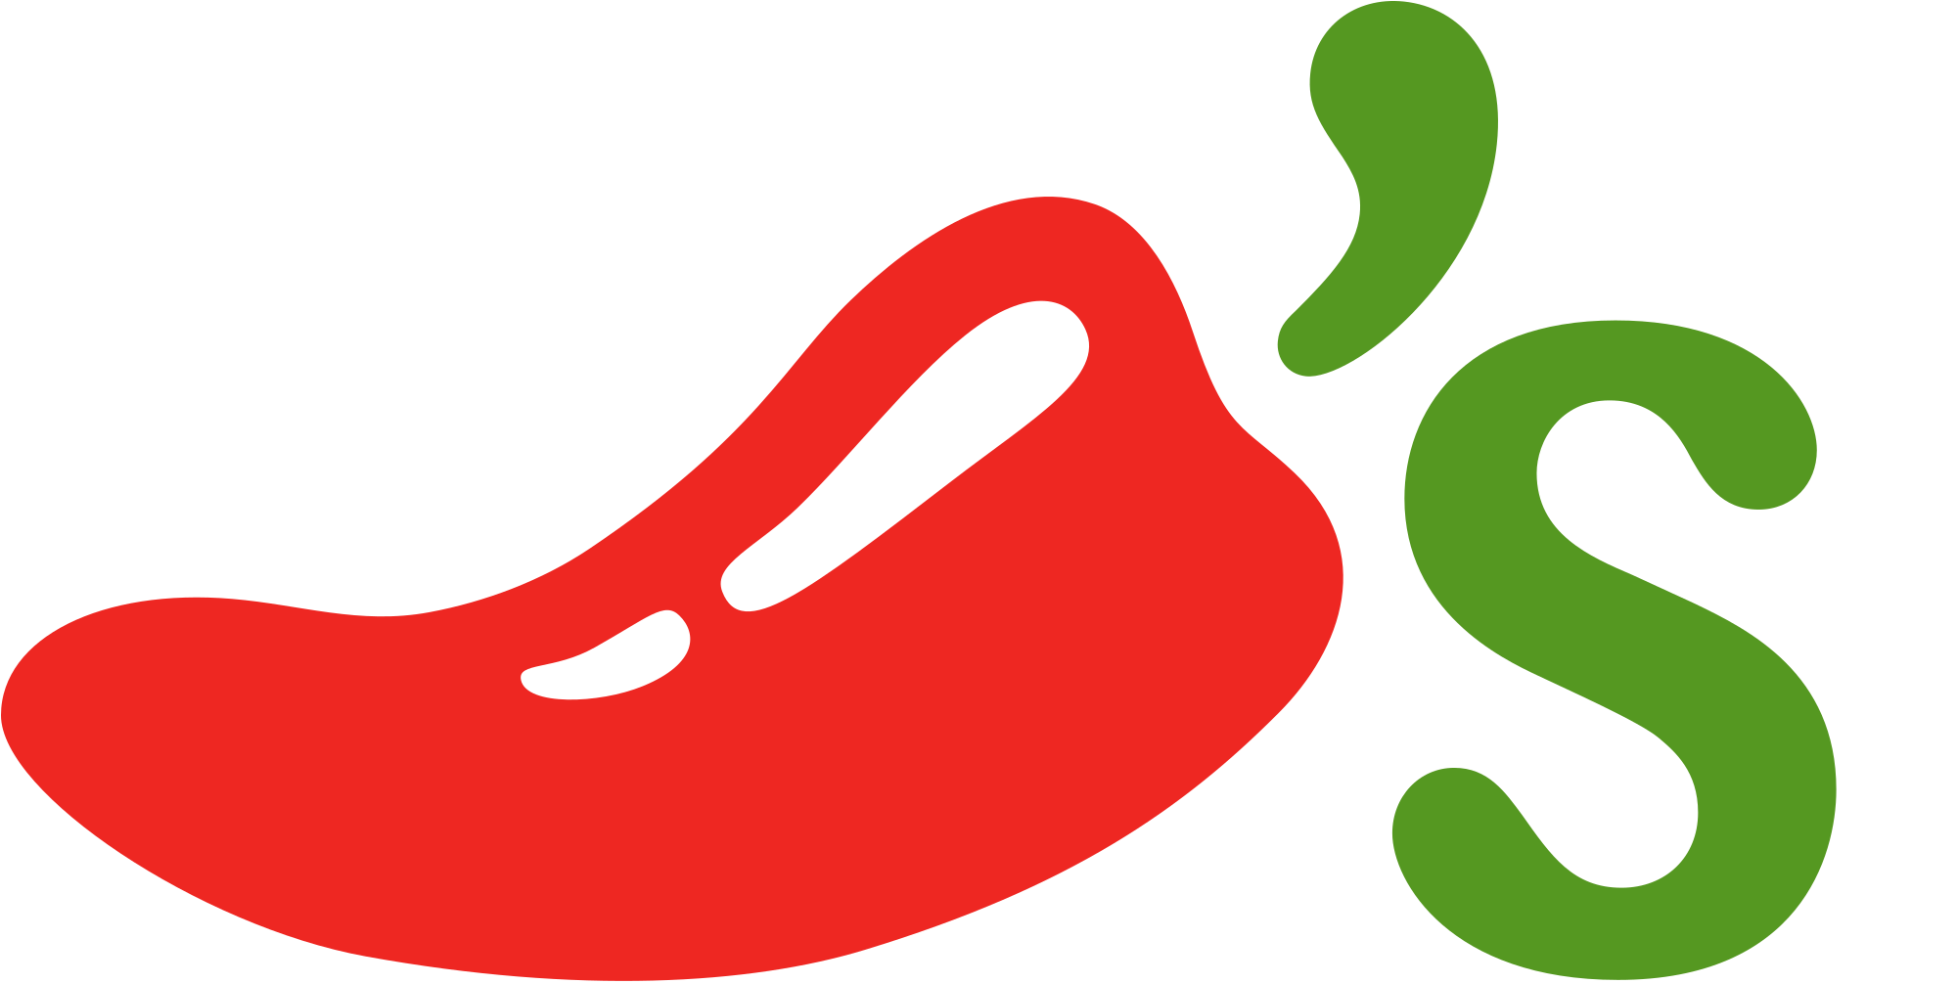
Top Logan's Roadhouse Competitors
72.3% would have gone to another restaurant as an alternative to Logan's Roadhouse
14.8% of recent Logan's Roadhouse guests considered visiting Texas Roadhouse
10.5% considered visiting Outback Steakhouse10.5% considered visiting Outback Steakhouse
8.3% considered visiting Olive Garden
8.1% considered visiting Applebee's
6.5% considered visiting LongHorn Steakhouse
5.3% considered visiting Chili's
Total base: 701 recent Logan's Roadhouse guests (Q3 - Q2'18)

Slide 4
Logan's Roadhouse Frequent Guest Demographic Skews
Male
Millennials
Caucasian
$50K - $75K
52.5% Of Logan's Roadhouse's frequent guest are Male compared to 57.4% across all CDRs
37.0% Of frequent guest are Millennials compared to 46.4% across all CDRs
66.7% Of frequent guest are Caucasian compared to 57.5% across all CDRs
24.7% Of frequent guest are $50K - $75K compared to 22.1% across all CDRs
Frequent guest = consumers that visit the chain once a month or more Base: 36,498 once a month+ fast casual consumers (Q3 – Q2‘18)

Slide 6
Food Attributes
Food Taste & Flavor
Food Quality
Based on your recent visit, how would you rate the chain on _________? Total base: 700 recent guests per brand (Q3 – Q2‘18) Showing percentage selecting “very good” (top-box rating)

Slide 7
Most Craveable Logan's Roadhouse Items
452 recent Logan's Roadhouse guests who rated the chain as "good" or "very good" for craveable items"

Slide 8
Accuracy Attribute
Order Accuracy
Based on your recent visit, how would you rate the chain on _________? Total base: 700 recent guests per brand (Q3 – Q2‘18) Showing percentage selecting “very good” (top-box rating)

Slide 9
Cleanliness Attributes
Cleanliness of Dishware and Silverware
Interior Cleanliness
Kitchen or Food Prep Area Cleanliness
Based on your recent visit, how would you rate the chain on _________? Total base: 700 recent guests per brand (Q3 – Q2‘18) Showing percentage selecting “very good” (top-box rating)

Slide 10
Overall Visit Satisfaction
Based on your recent visit, how would you rate the chain on _________? Total base: 700 recent guests per brand (Q3 – Q2‘18) Showing percentage selecting “very good” (top-box rating)

